Slide 1
Family Self-Sufficiency Program (FSS)
South central Minnesota multi county hra
Martin|Nicollet|Sibley|Waseca|watonwan counties

Slide 2
What is FSS?
FSS is a voluntary program.
Designed to support participants in accomplishing goals and building a stable financial future.
Finding strategies to become self-sufficient by working together with a FSS Coordinator.

Slide 3
What are the Benefits?
Support and guidance.
Referrals to community partners and resources.
Gain escrow savings account.
Overcome barriers.
Establish and work towards goals.
One step closer to homeownership.

Slide 4
Who Can Participate in FSS?
You must be receiving Housing Choice Voucher (Section 8) rental subsidy assistance.
Candidates most suitable are those who are not currently employed or under-employed who know they will have an increase in work in the next 1-4 years.

Slide 5
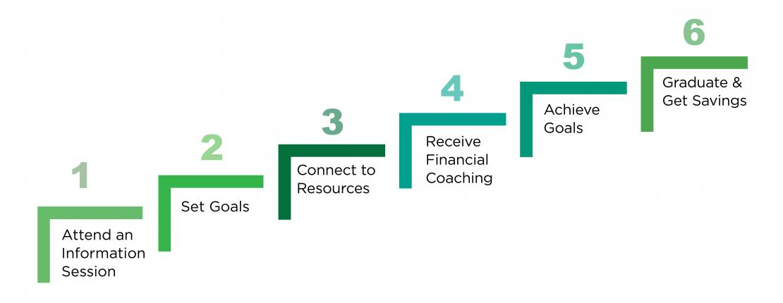
What are the Requirements to Graduate?
Apply to the program.
Sign a Contract of Participation.
Meet with your FSS Coordinator quarterly to discuss goal progress and more.
Must maintain suitable employment by the end of the contract.
Must be welfare free by the end of the contract.

Slide 6
What is the Contract of Participation (CoP)
Term of the contract is 5 years; there is potential to graduate earlier.
Outlines the requirements for the program.
Includes the Individual Training and Service Plans (ITSP) to outline goals.
Goals can be related to employment, education, training, and more!
Includes estimated completion dates for services, activities, and goals.

Slide 7
Sample ITSP Goals:
Obtaining full-time employment.
Job training – placement- retention
Obtaining a GED
Furthering education
English proficiency
Financial literacy
Credit Repair
Homeownership Counseling
Savings plans
Starting a business.

Slide 8
FSS Savings/Escrow Account
You are rewarded when you earn money!
When you or a household member increase your earned income, you get to save your monthly rent increase.
We will examine the increase and a contribution will be placed in an escrow savings account that builds interest for you.
This account is a powerful way to save for the goals you set in the program.
This account is established and maintained with no personal money.
You receive the money saved in the account when you successfully complete the program and graduate.

Slide 9
Escrow Example:
 | Housing Authority Portion of Rent | Tenant Portion of Rent | Total Rent
Beginning: | $500 | $100 | $600
Increase: | $300 | $300 | $600
Scenario #1:
At the start of the tenant’s contract they were paying $100 towards rent.
The tenant had an increase in earned income after starting a part time job.
Tenant’s rent portion increased from $100 to $300 a month.
The difference of $200 will be deposited into an escrow account every month.
Scenario #2:
The tenant’s job ends and their portion of rent decreases to $100.00.
Their escrow portion goes back to $0.
Scenario #3:
The tenant begins working a new job. Their portion of rent increases to $400.
Their escrow portion will be $300.00 per month.
Estimated Escrow Savings = $200.00 per month.

Slide 10
Client Stories:
Meet Susan:
“The FSS program was a rewarding program. It was great to have the support to reach goals that I have had for a while. My advice for participants is to keep going and to keep working on your goals. When you graduate it is an amazing feeling. I would definitely recommend this program to others!”
Susan graduated this program and received $8,228 in escrow funds. Susan is planning on using the funds to save and put towards a future home.
Meet Joe:
“The FSS program was a very useful resource to reach my goals. For those who are interested, I suggest you join the program! I will be using my escrow to pay for a home mortgage.”
Joe graduated this program and received $18,360 in escrow funds.

Slide 11
Resources:
Contract of Participation 2022
HUD FSS Program Material
FSS Guidebook

Slide 12
Contact Information:
Kaylie Rauchman
South Central MN Multi-County HRA
FSS Coordinator
(507)-345-1977 x6
kaylie@mycci.net

